Slide 1
AHCCCS Update

Slide 2


Slide 3
FY 17 Budget
Prop 123
KidsCare – July 26th
ALTCS Dental
Podiatry
HB 2442

Slide 4
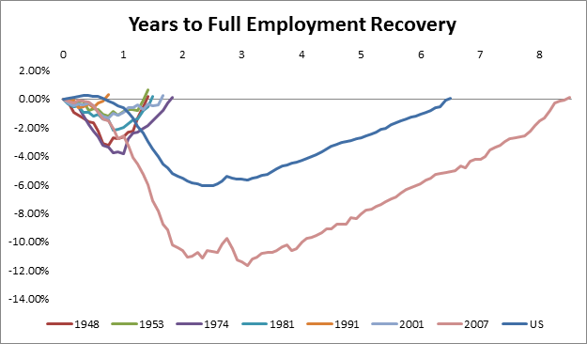
Employment and Recessions

Slide 5
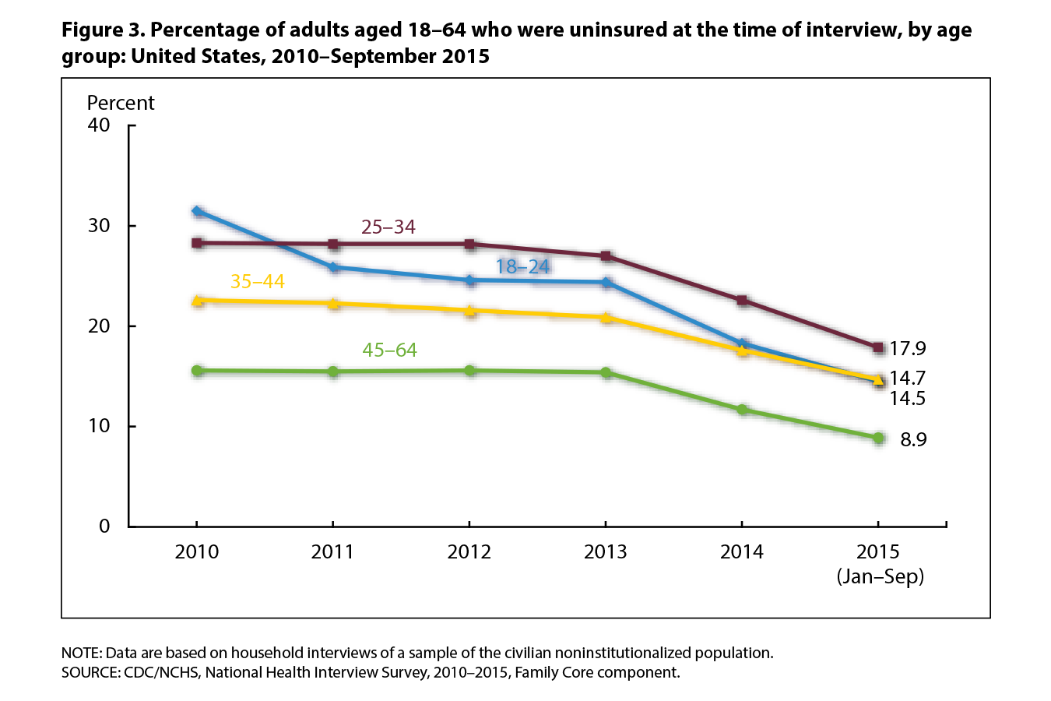
18-64 Uninsured Nationally

Slide 6
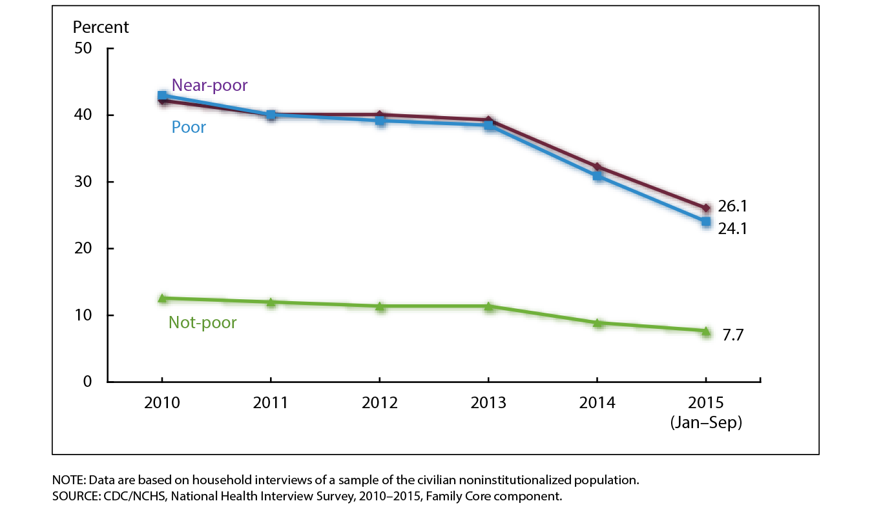
Insurance coverage by Economic Status

Slide 7
Expenditures for Restoration and Expansion

Slide 8
Average Annual Capitation Growth (%)

Slide 9
Eligibility and Payment Error Rate

Slide 10
Infant Mortality

Slide 11
CMDP

Slide 12
Children in Foster Care PMPM

Slide 13
Integration Efforts to Date
Ongoing – Duals – >40% alignment DSNP
2013 – 17,000 Kids with special needs
2014 – 20,000 Individuals with SMI – Maricopa
2015 – 19,000 Individuals with SMI – Greater AZ
2015 – 80,000 dual eligible members – Integrate BH
2016 – Administrative Merger
Future Possibilities
  2017 – 29,000 members with DD – BH & PH
  2018 – 34,000 Children with Autism or at risk
  2018 or future date – Non-SMI adults – BH

Slide 14
Health and Social Care Spending as a Percentage of GDP
Source: E. H. Bradley and L. A. Taylor, The American Health Care Paradox: Why Spending More Is Getting Us Less, Public Affairs, 2013.

Slide 15
Social/Economic Determinant Efforts
Multiple Plans have partnered to create and support community social service centers
MCO pilot to invest in low-income housing subsidy
AHCCCS has dedicated staff resources focused on housing – employment – peer services
State only investments made through RBHAs
State Housing Funding for Individuals with SMI

Slide 16
The Network – Growth
All Participants

Slide 17
AHCCCS VBP Fee Schedule Changes
2014 – Hospital IP – APR-DRG
2015 - MCOs pay FQHC full rate
2016 - Hospitals bump for sharing data with HIE and meeting MU2
2016 - SNFs – increase for those above avg with pneumococcal vaccine
2016 - Integrated Clinics- physical health
2016 – stand alone ED – new provider type
2016 – Treat and Refer
Notes:
a

Slide 18
CMS Regulations Tsunami
Access Requirements
New Outpatient Drug
Proposed MCO requirements
Parity Requirements
Home and Community Based Requirements
DOL – Overtime Requirements
Capitation Rate Reviews

Slide 19
Total Medicaid Managed Care Spending

Slide 20
MCO Regs
Finance Cap Rates – MLR –
State Plan – enrollment – State Monitoring
Enrollee Rights and Protections
MCO Standards –
Quality Management
Program Integrity
Sanctions

Slide 21
Dreamland by Sam Quinones
1980 - Porter and Jick – 1 paragraph
1990 Scientific American called it “an extensive study”
Paper for Institute for Clinical System Improvement “a landmark report”
2001 Time Magazine “landmark study” that addiction concerns “basically unwarranted”
1998 over 1,000 multi-disciplinary pain clinics – 7 years later 85
Purdue marketed OxyContin as having less than 1% addiction

Slide 22
Dreamland
1997 – 670 k Oxy scripts – 2002 – 6.2 m
US consumes 83% of world’s oxycodone and 99% of world’s hydrocodone (Vicodin and Lortab)
Overdose deaths rose from 10 per day in 1999 to 48 in 2012
Book describes how Heroin distribution evolved and changed during this same time
Actions
Read book
OIG CONG Strategies
Evaluate opportunities in plan meetings

Slide 23
Learning and Action Network
Resources
Activities
Impact
Long-Term Outcome
Interim Outcomes
Time (18 months)
Communications Infrastructure
GC Member Networks & other organizations (“multiplier effect”)
CAMH Staff
CMS Support/Staff
Work Groups
Adoption Acceleration
30% APMs by 2016
50% APMs by 2018
Better Care, Smarter Spending, and Healthier People
Engagement
Alignment
Targeted agreement on components
Individual reach-outs
Large stakeholder meetings
Affinity Group
Webinars
Newsletters
Events/conferences
Blogs, social media, crowdsourcing
Collaboration Portal
Media
Reach
APM lessons broadly communicated
Action
APMs implemented
Notes:
We’ve achieved progress in reach and alignment. Now we need to emphasize action.

Slide 24
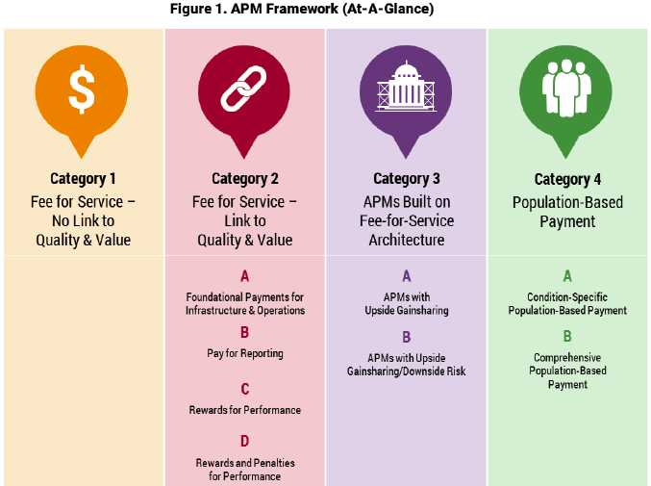
LAN Payment Reform Framework
Notes:
Can we do this one without the boxes/arrows? Concept is ok but leaves out a range of reform types
Done

Slide 25
Pbp and cep work groups
Population-Based Payment (PBP)
Work Group
  Sprints Launched
  Patient Attribution
  Financial Benchmarking
  Performance Measurement
  Data Sharing
Clinical Episode Payment (CEP)
Work Group
  Sprints Launched
  Elective Hip and Knee Replacement
  Maternity
  Cardiac Care
Notes:
Tom Betlach:
In this slide, you see that the CEP and PBP Work Groups are well on their way in their charges. As you know, we’re in the comment period for the draft Patient Attribution and Financial Benchmarking papers, which closes March 7. The PBP Group is now well into its performance measurement and data sharing sprints.
Besides the draft Elective Joint Replacement White Paper that we’ll be discussing today, the CEP work group is moving ahead on its sprints. This Friday, the CEP Work Group is opening its comment period on Elective Hip and Knee Replacements and we’ll be accepting comments through March 28 . In March the group will be releasing its Draft White Papers on Maternity and Cardiac Care bundles. You can find more information about these work products on our Web site (www.hcp-lan.org/).
We’re currently in the draft phase of these topics. You should know that once your input and comments have been incorporated and the final papers released, our next step will be conducting some pilots of these recommendations. We will be looking for organizations to partner with on these pilots, and we look forward to your engagement in all of these efforts.

Slide 26
Proposed Funding (In Millions)
Program | DY 1 | DY 2 | DY 3 | DY 4 | DY 5 | Totals
American Indian CMC | 35 | 35 | 35 | 35 | 35 | 175
Justice | 20 | 20 | 20 | 20 | 20 | 100
BH/PH Int. Adults | 137.5 | 137.5 | 137.5 | 137.5 | 137.5 | 687.5
BH/PH Int. Kids | 137.5 | 137.5 | 137.5 | 137.5 | 137.5 | 687.5
Totals | 335 | 335 | 335 | 335 | 335 | 1,675

Slide 27
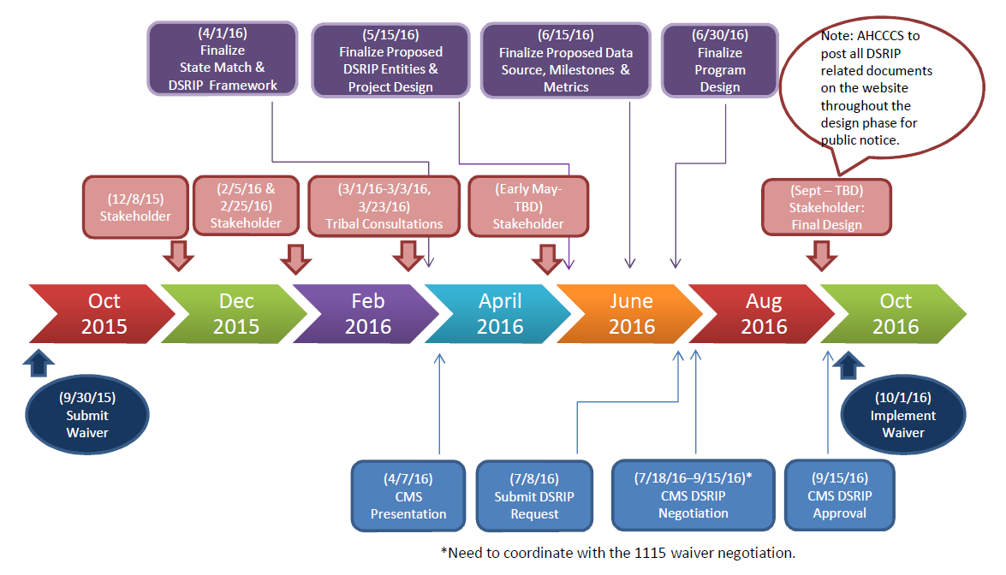
DSRIP Timeline

Slide 28


Slide 29
Employee Engagement

Slide 30
Lean Management System Update
Executive Branch Fundamentals Map
Governors Scorecard
Breakthrough Measures
Counter Measures
Visual Management Boards
Division Process Improvement Projects
Division Lean Champions
Training and Communication

Slide 31


Slide 32
Questions?

